Slide 1


Wildlife monitoring
Chirith Kumar M
Chandan J
Jagadish M
Mentor : Sanjay S C
College Name – Sri Sairam college of engineering

Slide 2

Project Objectives
Problem Statement
Introduction
End Users
Main Factor in Project
Flow of Project
Result
Conclusion
Future Perspective

Slide 3
Problem Statement
Wildlife conservation areas face a lot of significant challenges in continuously monitoring animal movement and detecting unauthorized human intrusion in live. Traditional surveillance methods rely on manual observation only, which is inefficient in use, labor-intensive, and often fails to provide real-time information on time. This limitation increases the risk of poaching, habitat disturbance, and delayed emergency response.
The demand exists for an intelligent automated monitoring system capable of detecting motion in real-time, collecting data, and making notifications without the need for human supervision at all times. Using a Python computer vision solution could fill this need and help with ongoing surveillance of wildlife as well as provide more accurate methods for identifying wildlife, allowing conservation agencies to make quicker decisions based on the results..

Slide 4
Introduction
Due to a number of reasons, including habitat destruction, poaching, and increasing human-animal conflict, there has recently been an increase in the need to conserve wildlife. Traditional methods of monitoring wildlife are cumbersome, labor-intensive, and generally not sufficient for real-time decision-making in larger forested regions.
This proposal is for a smart monitoring system that automatically detects animal activity through computerized visualization and motion detection using python code. The system will consist of camera input for picture taking, image processing algorithms, and an alerting mechanism to allow continuous observation of the landscape being monitored, capturing "important/ significant" events, and notifying authorities upon detection of abnormal animal behaviour.
The use of Python and modern vision libraries will provide an accurate, low-cost, and scalable means to monitor wildlife, making it easier to conserve wildlife in such a way as to be more effective and efficient. The technical advancement provided by the python software system will benefit the conservation of wildlife by reducing the need for human involvement in the process of monitoring wildlife as well as increasing the amount of ecological data collected by conservationists through the system.

Slide 5
End Users
The Smart Wildlife Monitoring System is an effective tool for people and businesses engaged in wildlife protection/environmental management.
The primary users will be:
Forest Departments - for monitoring wildlife activity and preventing illegal hone invasions
Wildlife Conservation Agencies - for establishing the movements of animals and protecting endangered species
National Parks/Sanctuaries - for increasing surveillance and safety of visitors
Anti-Poaching Teams - for providing real-time alerts and facilitating rapid responses
Environmental Researchers - for gathering wildlife movement data

Slide 6
Main Factors in Project
Computer Vision For Real-Time Motion Detection To Support Ultra-Fast Monitoring Of Nature's Activity
Autonomous Image Capture Without Human Oversight
Real-Time Alerts Provide An Immediate Method Of Responding To Unusual Motion
Low-Cost, AI-Enabled Monitor That Works In Remote Forests
Continuous Monitor With Minimal Number Of People Monitoring
Expandable Design Allows For The Expansion Of A Large Number Of Wildlife Areas
Technology Using Python, Computer Vision And Automation To Help Preserve Nature

Slide 7
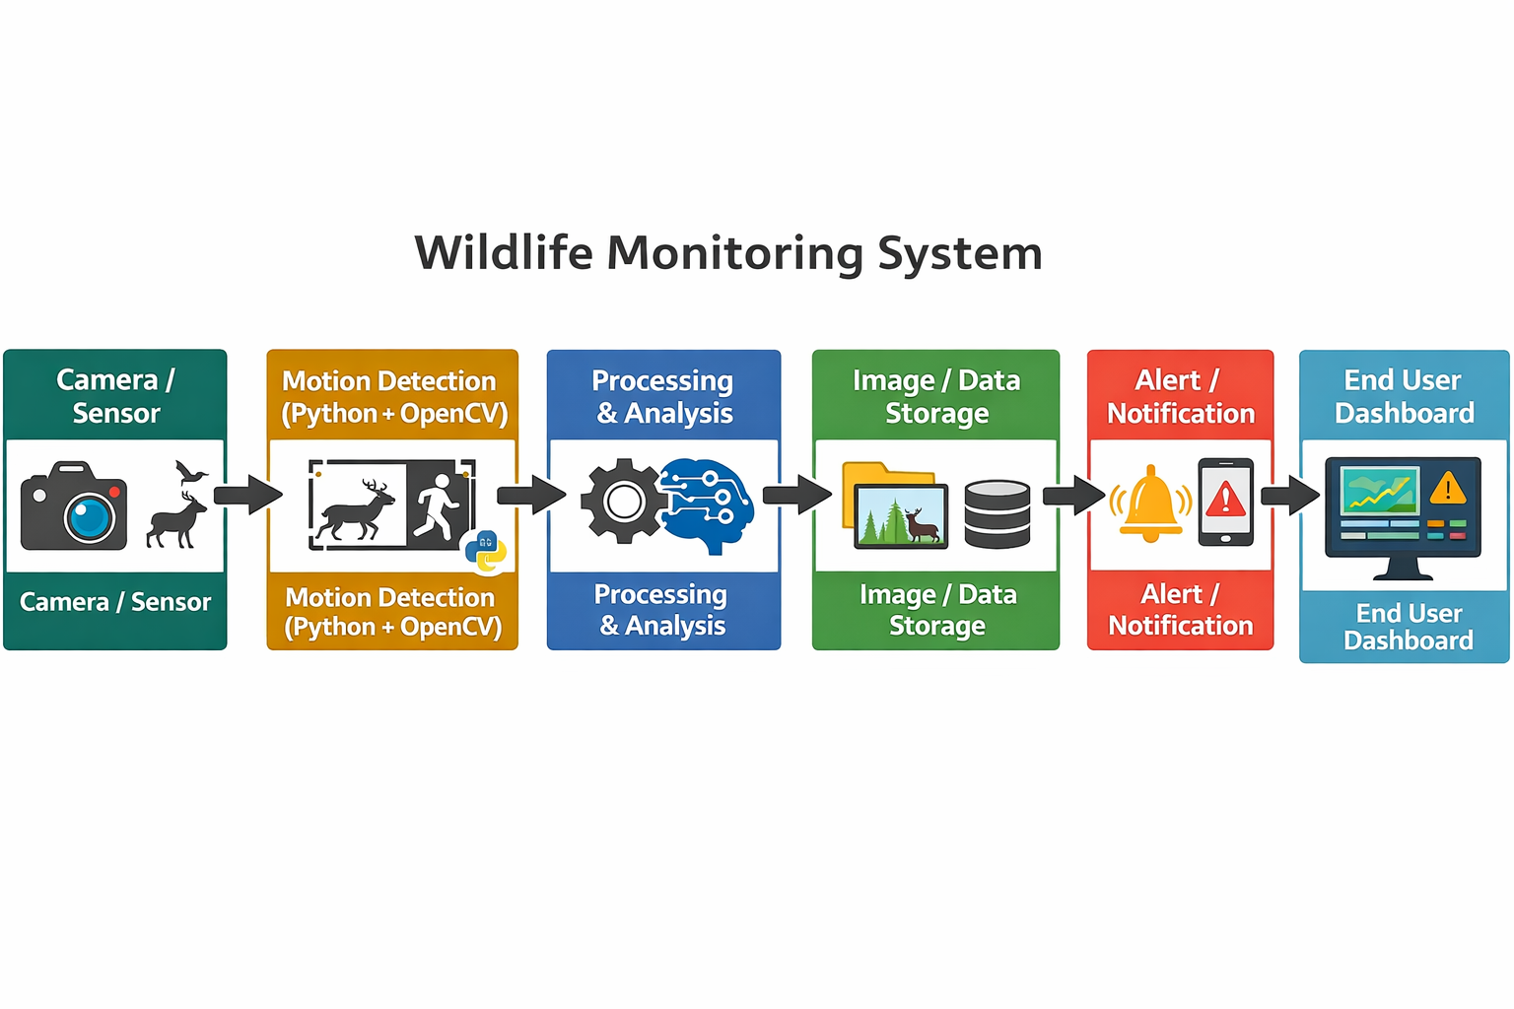

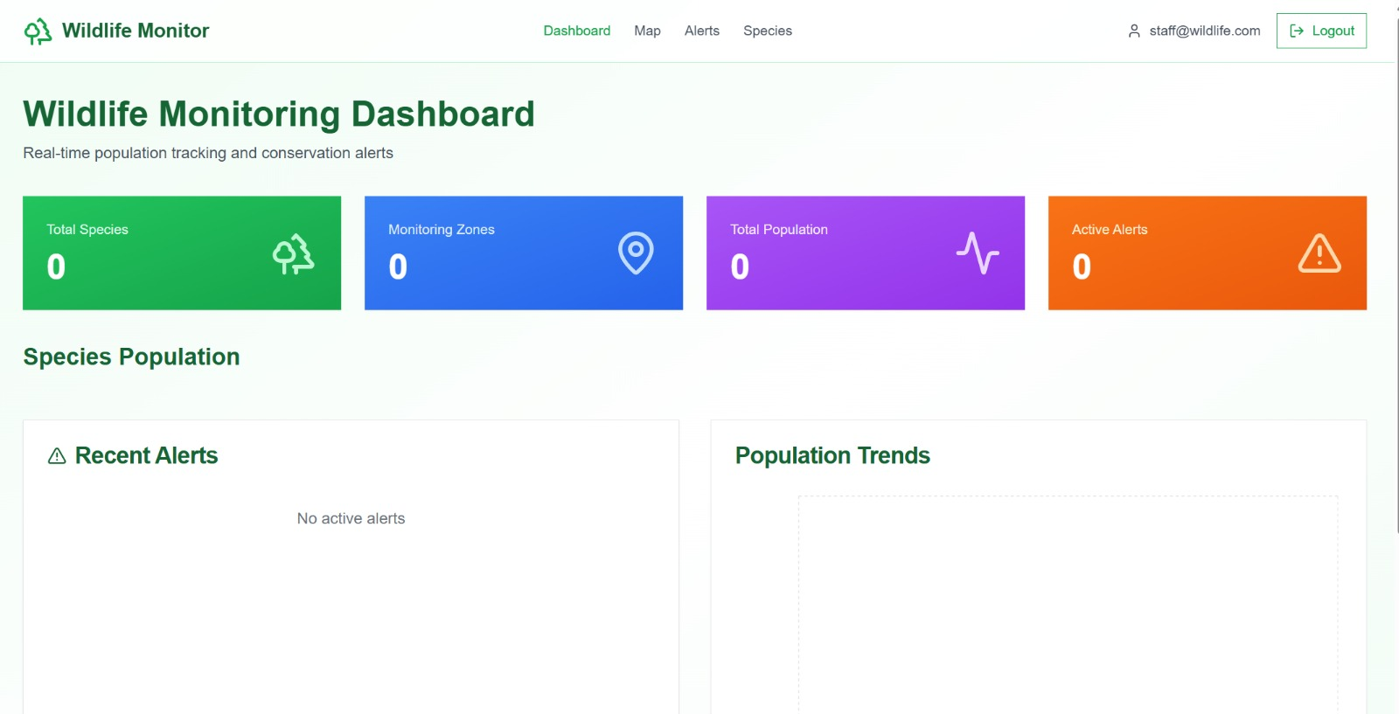
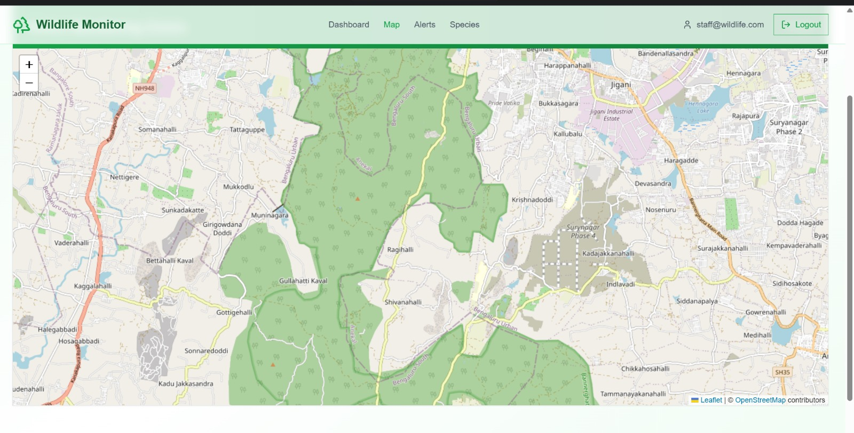
Flow of Project

Slide 8
Technology Stack
Software Technologies
Python → Core programming language for system logic
OpenCV → Motion detection & image processing
NumPy → Frame/data processing
TensorFlow → Animal recognition
File handling → Image/data logging
Hardware Technologies
Camera module / Webcam → Captures wildlife footage
Computer → Runs Python processing
Storage device → Saves captured data
Wi-Fi module → Data transmission

Slide 9
Result:
Motion detected at any given moment in a monitored location.
Automatic capture and storage of videos/photos of wildlife.
Alerts immediately upon motion detection.
Monitored continuously; little to no human involvement.
Reliable log keeping of wildlife behavior.
Increased efficiency for monitoring wildlife in difficult to monitor areas.
Low-cost, scalable monitoring system.

Slide 10
Conclusion
The Python-based Wildlife Monitoring System shows how computer vision and automation can greatly enhance wildlife surveillance.
It allows for real-time motion detection, automated image capture, and alert generation. This reduces the need for constant human monitoring and boosts efficiency and responsiveness.
This project showcases the practical use of Python and modern vision technologies in conservation efforts. It offers a low-cost, scalable solution that aids wildlife protection, data collection, and quicker decision-making. Overall, the system illustrates how technology can significantly contribute to protecting natural ecosystems and encouraging sustainable conservation practices.

Slide 11
Future Perspective
The Wildlife Monitoring System presently represents a solid basis for automated wildlife tracking. Automated wildlife monitoring capabilities could be greatly enhanced by more advanced technology. For example, AI-based animal recognition could provide automated identification of animal species, which would provide for more precise behavior assessment. Additionally, additional wireless sensor networks and drone/ UAV monitoring could enhance the initial animal tracking system by increasing the size of the area being monitored in the forest.
Using cloud-based analytical tools and predictive models, animal migration patterns could be tracked, and threats to animals could be identified proactively.
Using renewable energy sources to support equipment, and providing durable hardware would extend the life of the monitoring system and allow it to function in remote locations. With a commitment to development over time, a fully intelligent conservation solution — generating real-time decisions about how to manage wildlife and their ecosystems — is attainable.

Slide 12
Thank You
Notes:
Thank You !!

